Slide 1


Application to i-Hub
Startup/ Project / Team Name: NetGlide
Applicant/Founder Name: Janmejay Acharya Mobile No: 9104620244
Email Id:janmejay.acharya2006@gmail.com
Website: https://netglide.in

Slide 2
Elevator Pitch (Not more than 50-70 words)
Colleges and companies still force users to work inside generic browsers that either block access or leak sensitive activity. NetGlide is a secure, institution-controlled browser built for environments where privacy and oversight both matter. It personalizes the experience by role, works inside restricted networks, and keeps all monitoring data completely private — never leaving the organization.

Slide 3
Problem
Students and employees lose time to blocked sites, restricted portals, and constant IT friction.
Institutions and companies have almost no private visibility into internal browsing activity.
Mainstream browsers (Chrome, Edge, Opera) are designed for consumers, not for secure institutional or corporate environments.
Existing monitoring tools either invade privacy or push sensitive data to external servers.
This creates a daily gap for colleges, schools, and private organizations that handle confidential work.

Slide 4
Solution
NetGlide is a purpose-built secure browser for institutions and companies that need control without compromise.
It is designed to:
Work inside restricted / campus / corporate networks
Personalize experience by role (Student, Faculty, Employee, Legal, Finance, Admin)
Provide private internal monitoring for authorized administrators
Keep all activity data inside the organization
No external tracking. No third-party analytics. Built for privacy-sensitive environments.

Slide 5
Product
Working MVP already developed
Key capabilities:
Role-based personalization
Secure internal browsing experience
Private institutional / company monitoring dashboard
Workspaces, bookmarks, history and controlled settings
Lightweight architecture suitable for labs and office systems
Live presence: netglide.in

Slide 6
Unique Selling Proposition
Built for both education institutions and private companies that need secure internal control
Dual value: better user experience + private organizational oversight
Zero external data collection — monitoring stays fully inside the organization
Role-based experience not offered by mainstream browsers
Already exists as a working product, not just a concept

Slide 7
Market Opportunity
Two clear markets:
Education
40,000+ colleges and schools in India
40+ million students
Strong need for campus control + student productivity
Private Companies / Secure Workplaces
Organizations handling confidential data, legal work, finance, research, and internal operations
Growing demand for private, controlled browsing environments without external leakage
Almost no product currently serves both segments with a privacy-first institutional model.

Slide 8
Competitors and Competitive Advantage
Primary competitors: Google Chrome, Microsoft Edge, Opera GX, and generic enterprise monitoring tools.
NetGlide is different because:
Designed for restricted institutional and corporate networks
Role-based personalization
Private monitoring that never leaves the organization
Suitable for both education and security-sensitive private companies
This is not another consumer browser.
It is an institutional secure browsing layer.

Slide 9
Recommendation from Industry / Academia Expert
B2B Institutional & Enterprise Licensing
Annual Institutional License (colleges / schools)
Department or Team License
Private Company / Enterprise License
Free pilot → paid conversion
Premium features: custom branding, access controls, advanced private analytics

Slide 10
Business Model
Mentorship on institutional and enterprise sales
Access to colleges, schools, and private organizations for pilots
Support for IP / trademark protection
Pathways to seed grants and incubation
Introductions to decision makers in education and secure enterprise environments

Slide 11
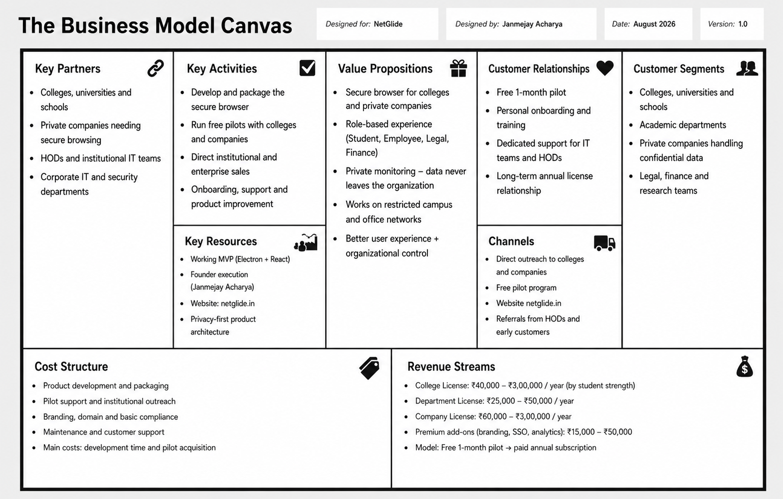
Business Model Canvas

Slide 12
Your expectations from i-Hub
Mentorship on institutional and enterprise sales strategy
Access to colleges, universities and private companies for structured pilots
Guidance on product packaging, pricing and go-to-market
Support for trademark / IP protection
Pathways to relevant grants and seed opportunities
Introductions to decision makers in education and secure enterprise segments
Credibility and network support to help NetGlide move from MVP to early institutional adoption

Slide 13
Team
Janmejay Acharya – Founder & Product
B.Tech Information Technology, JG University
Built the complete working MVP of NetGlide
Leads product vision, development, and institutional outreach
Website & desktop application: netglide.in
Kapil – Full Stack Developer
Handles full stack development of NetGlide
Works on core features, integrations, and overall system stability
Supports both frontend and backend development needs
Om Goswami – Development Support
Supports product development and feature implementation
Assists in testing, improvements, and overall execution
Helps keep the product stable for pilot use
Current Stage: Working MVP ready for institutional and company pilots
Team Focus:
Run free pilots with colleges and private companies
Improve product based on real feedback
Convert early pilots into paid licenses

Slide 14
Budget Plan
Sr No | Category | Item | Cost (₹)
1 | Product Development | Security hardening, packaging & installer | 70,000
2 | Cloud & Infrastructure | Update server, hosting & basic backend | 55,000
3 | UI/UX & Features | Role-based improvements & polish | 45,000
4 | Testing | Cross-device, security & performance testing | 50,000
5 | Pilot Deployment | College with 3–5 colleges (setup + support) | 60,000
6 | Outreach & Marketing | Demo materials, LinkedIn ads, outreach | 40,000
7 | Legal & Compliance | Basic legal docs, privacy policy support | 30,000
8 | Mentorship & Consulting | Product & GTM guidance | 50,000
 | Grand Total |  | ₹4,00,000

